Slide 1
Advice bot
Ai For Good

Slide 2
About Our Hack.
We are targeting a need brought up in our investigations into what the 999 and 111 lines are predominantly used for and how best they could be helped. We will take the strain off of emergency service lines by filtering out people who need ‘distracting’ or are just lonely.
We will offer a non judgemental and non human voice for a person to talk to.
We will be able to signpost or forward to emergency services if necessary.

Slide 3

What our Ai can currently Help with.
Self Harm, Drug addiction,
suicidal thoughts and actions,
burns, loneliness, money issues,
Overdoses, housing issues,
both physical and emotional abuse
As well as distraction from self
harm.
After speaking to some paramedics it seems that the biggest thing for people who are in danger of harming themselves is to get a temporary distraction until they are over the need to hurt themselves. At the moment mental health services are over-run and struggling, this would help filter patients.

Slide 4
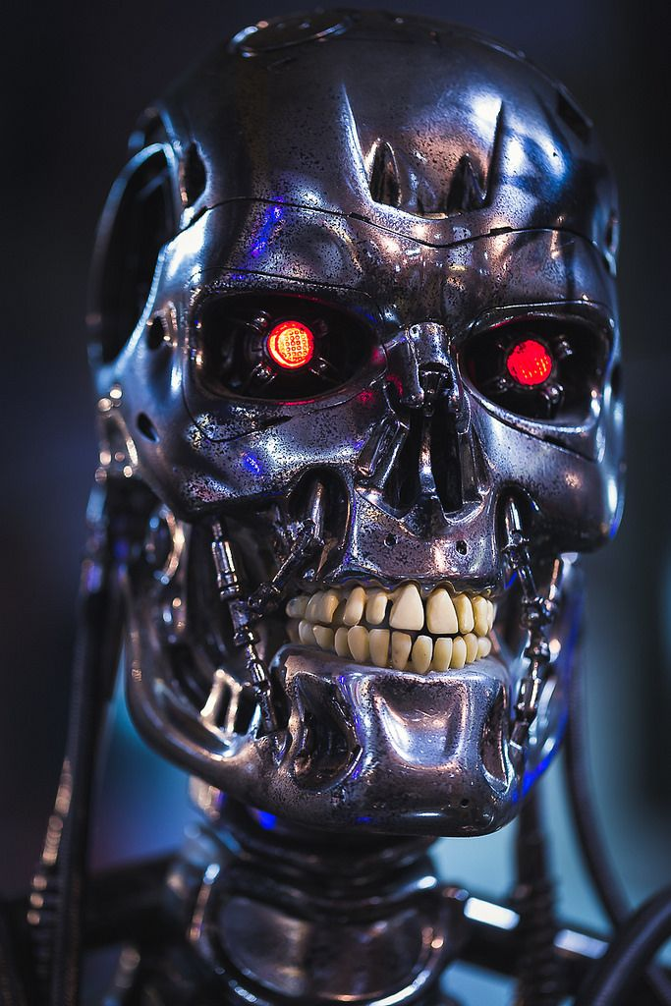
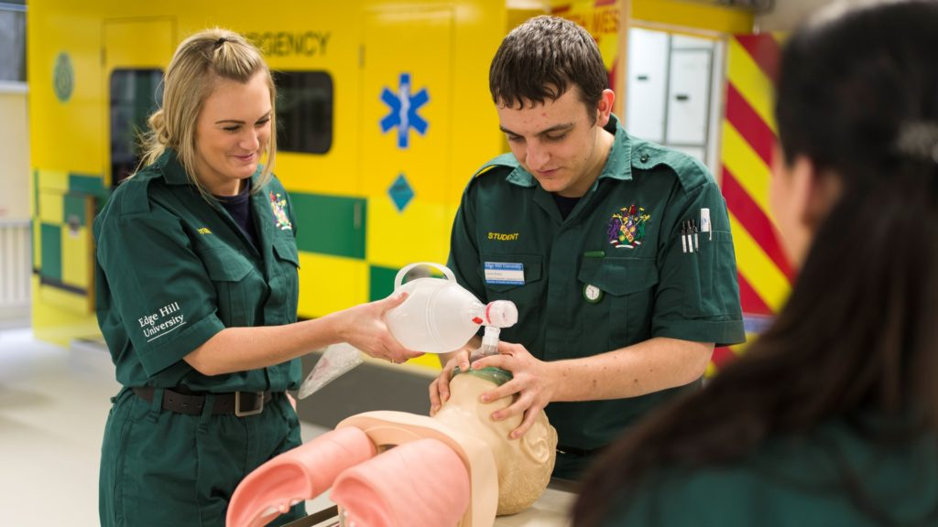
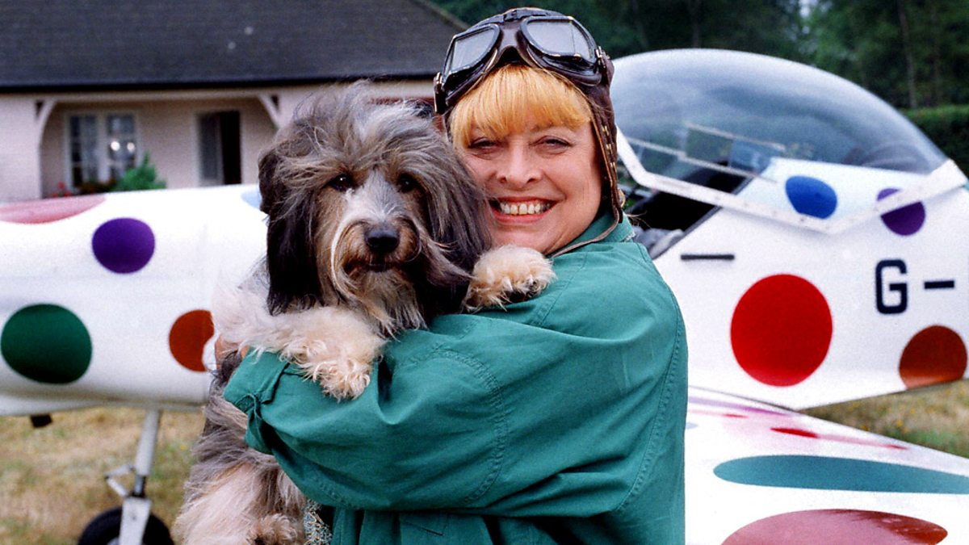
And Humanity
The best of Artificial intelligence
We consulted paramedics to make sure we were following the same rules and regs to insure we could comfort the caller while also giving the best advice and help, from loneliness to medical help we want to make sure we good for the people who trust us.
An Ai that has been trained with over 250 individually recognised mindsets from people in crisis. The AI is able to tell what issue you are having by the tone of your voice and the words you use.

Slide 5

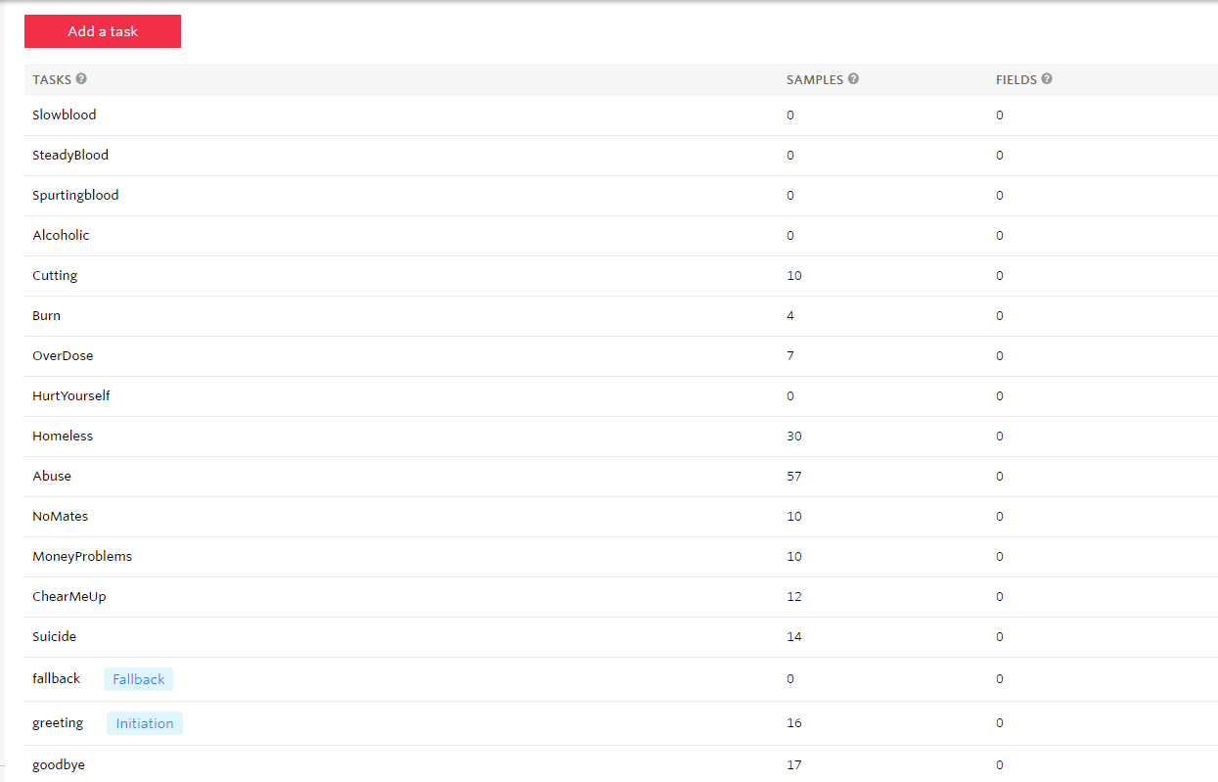

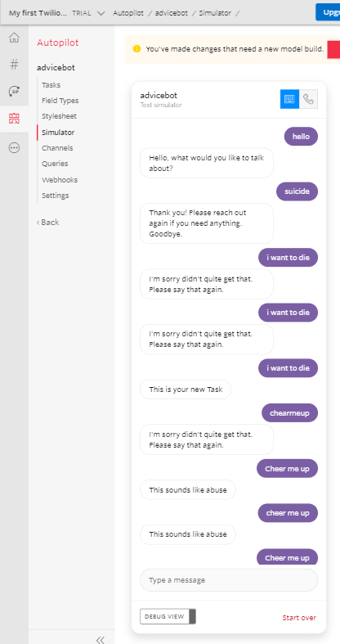
Meet T800
So how can you try it?
You can call Number Or Web address
And help it develop

Slide 6
Demo

Slide 7
Makers
Future integrations in testing: Facebook messenger
Email Contact
Integration into 999 Calls to help automate and collect information quickly for paramedics
Developer, Jennifer
Developer, Chloe
Head of human relations, Shannon
NHS Expert, James

